Slide 1
Health Literacy at
Robert R Leverence MD FACP
Vice Chair Clinical Affairs Dept of Medicine
January 20,2017

Slide 2
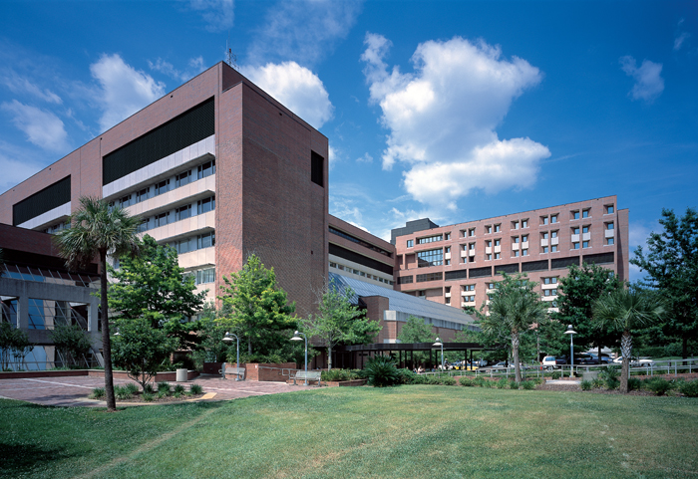
With campuses in Gainesville and Jacksonville, UF Health includes six health colleges,
nine research institutes and centers, two teaching hospitals, two specialty hospitals
and a host of physician medical practices and outpatient services throughout
north central and northeast Florida.
Our mission is to promote health through outstanding and high-quality patient care;
innovative and rigorous education in the health professions and biomedical sciences;
and high-impact research across the spectrum of basic, translational and clinical investigation.
Notes:
Let me briefly tell you a little bit about ourselves. As most of you know the university of Florida is a research intensive public university as is the academic medical center there. It also happens to be a safety net institution for north central Florida. And so many under-insured and uninsured patients pass through our doors.
Despite what you hear in the news about national healthcare, there have been some positive trends in recent years. One of them is we are becoming more and more quality metric driven. For the first time in history, technology now allows us to track things we could never track before. We follow readmission rates, ED usage by pts, patient satisfaction, even uptake of advance directives. You name it and we can now measure it.
This is a new transparency we’ve never had before which quickly brings to light any inequalities. One inequality you know better than anyone is limited health literacy. We know it is associated with all kinds of bad things from more hospital readmissions to higher mortality rates.

Slide 3
Outline
Implementation of a Routine Health Literacy Assessment at an Academic Medical Center. A Descriptive, Multi-method Study. PI: Robert Leverence MD
Implementation of a Health Literacy Assessment in Perioperative Coordinated Care. PI: Nila Radhkrishna
Advance Directives Completion Rates and an Intervention to Address Health Literacy in a Clinic Population. PI: Melanie Hagen MD
Notes:
But how did this all begin?

Slide 4
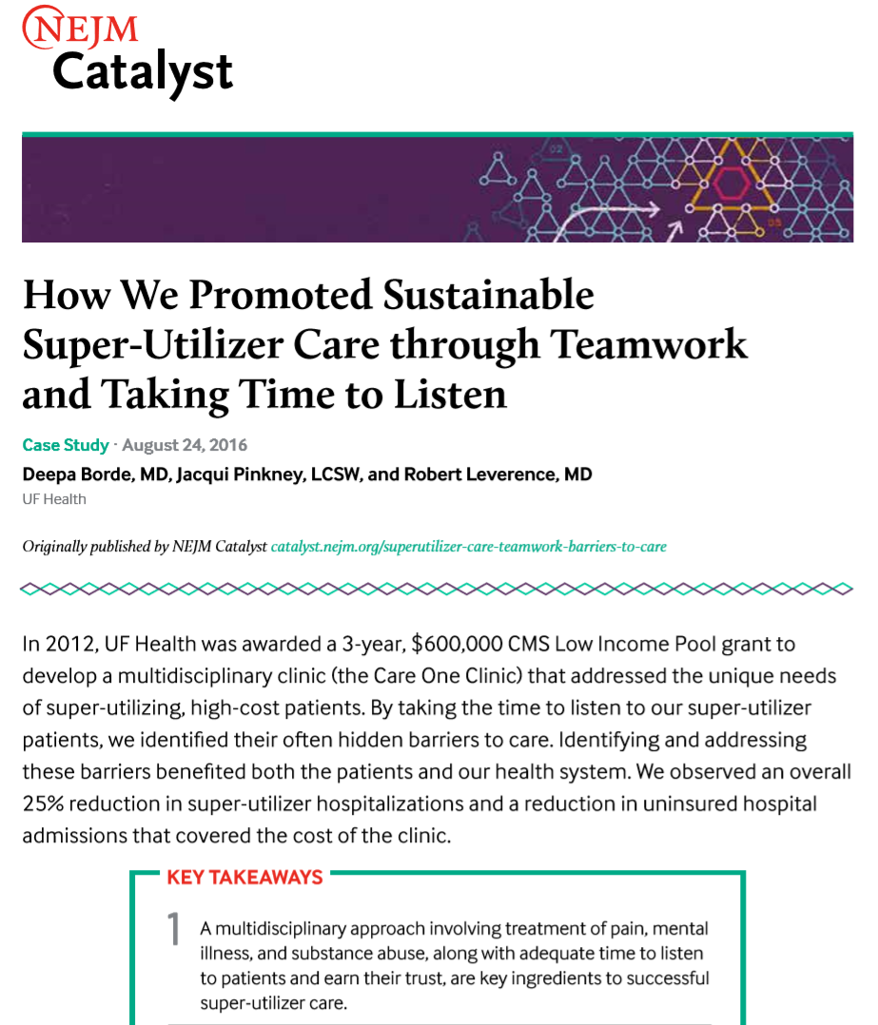
Notes:
So how did this work come about? As I mentioned we are a safety net institution and so we have many pts with LHL, but our particular story started with the development of a super-utilizer clinic at UF Health back in 2012. This clinic was put in place to better meet the needs of the 400+ patients at the time who frequented our ED because of untreated mental illness, no insurance, an addiction. Often times they had all 3. As you can imagine, this population had a high rate of limited health literacy – about a 3rd of them.
So that was the spark which ignited the engine, but what’s kept it running is the groundswell of enthusiasm by our nurses and social workers and librarians.
I can’t say the same however for healthcare community as a whole. I think the problem is that CMS has put forward so many quality metrics in place that most facilities are hamstrung just trying to satisfy those, not leaving any room for others.

Slide 5
Implementation of a Routine Health Literacy Assessment at an Academic Medical Center. A Descriptive, Multi-method Study
Methods
A hospital-wide brief health literacy assessment was initiated by nurses in April 2014 and applied to all adult inpatients. Results were documented in the electronic health record, which then generated care plans and alerts for patients who screened positive.
A nursing survey showed good ease of use and adequate patient acceptance of the screening process.
Six months after hospital-wide implementation, retrospective chart abstraction of 1455 patients showed 84% were screened.
We conclude that a routine health literacy assessment can be feasibly and successfully implemented into the nursing workflow and electronic health record of a major academic medical center.
Results
Conclusion

Slide 6
Rapid Estimate of Adult Literacy in Medicine-Short Form (REALM-SF)

Slide 7
REALM-SF: Instructions for Administration
1. Give the patient a copy of the Rapid Estimate of Adult Literacy in Medicine-Short Form and explain reason for the procedure to patient: “We as a team want to make sure that we provide the best education to our patients. Please read as many words as you can from this list. Begin with the first word and read out loud. When you come to a word you cannot read, just skip it and go on to the next word.” 2. If patient is apprehensive or resists doing the screen, you can respond as follows: “We want to be sure that we are communicating to you in a way you can understand. Like when I take my car to get repaired, they may say “crank shaft gasket,” and I don’t understand it. In hospitals, we use words that many people find confusing. We want to make sure that we communicate in the best way for you.” 3. Scoring: If patient takes more than 5 seconds on a word, coach them to proceed to the next word. If patient begins to miss every word, have him or her speak only known words. 4. Count how many words the patient was able to speak correctly.

Slide 8
REALM-SF: Instructions for Administration
1. Give the patient a copy of the Rapid Estimate of Adult Literacy in Medicine-Short Form and explain reason for the procedure to patient: “We as a team want to make sure that we provide the best education to our patients. Please read as many words as you can from this list. Begin with the first word and read out loud. When you come to a word you cannot read, just skip it and go on to the next word.” 2. If patient is apprehensive or resists doing the screen, you can respond as follows: “We want to be sure that we are communicating to you in a way you can understand. Like when I take my car to get repaired, they may say “crank shaft gasket,” and I don’t understand it. In hospitals, we use words that many people find confusing. We want to make sure that we communicate in the best way for you.” 3. Scoring: If patient takes more than 5 seconds on a word, coach them to proceed to the next word. If patient begins to miss every word, have him or her speak only known words. 4. Count how many words the patient was able to speak correctly.
“We want to be sure that we are communicating to you in a way you can understand.
Like when I take my car to get repaired, they may say “crank shaft gasket,” and I don’t understand it.
In hospitals, we use words that many people find confusing.
We want to make sure that we communicate in the best way for you.”

Slide 9
 | Health Literacy - REALM-SF Compliance and Prevalence Data
 | Patients Admitted September 23 – October 20, 2014
 |  |  |  | Compliance With Use of Tool |  |  |  |  | Prevalence of Health Literacy Levels
 | Unit |  | # Admitted | # Screened | % Screened |  | # Adequate | # Limited | # Unable to Assess | % Adequate | % Limited | % Unable to Assess
 | General Medicine, South Wing |  | 149 | 129 | 87% |  | 107 | 12 | 10 | 83% | 9% | 8%
 | General Medicine, East Wing |  | 141 | 131 | 93% |  | 105 | 18 | 8 | 80% | 14% | 6%
 | General Medicine Teaching |  | 175 | 143 | 82% |  | 91 | 46 | 6 | 64% | 32% | 4%
 | Family Medicine |  | 224 | 202 | 90% |  | 137 | 53 | 12 | 68% | 26% | 6%
 | Cardiology |  | 149 | 137 | 92% |  | 112 | 25 | 0 | 82% | 18% | 0%
 | Surgery |  | 159 | 97 | 61% |  | 86 | 9 | 2 | 89% | 9% | 2%
 | Labor and Delivery |  | 201 | 189 | 94% |  | 179 | 10 | 0 | 95% | 5% | 0%
 | Orthopaedics |  | 132 | 110 | 83% |  | 98 | 8 | 4 | 89% | 7% | 4%
 | Urology |  | 125 | 82 | 66% |  | 72 | 10 | 0 | 88% | 12% | 0%
 | TOTAL |  | 1455 | 1220 | 84% |  | 987 | 191 | 42 | 81% | 16% (95% CI, 13-18%) | 3%

Slide 10
Implementation of a Routine Health Literacy Assessment at an Academic Medical Center. A Descriptive, Multi-method Study
Next Steps?
For inpatients with limited health literacy, pharmacy tech to review all meds at discharge.
Currently being piloted.
Notes:
Nurses have done a great job screening but are finding it hard to fit in detailed med teaching.
So we are piloting having pharmacy techs do that.

Slide 11
Implementation of a Health Literacy Assessment in Perioperative Coordinated Care
Methods
We used the REALM-SF to screen patients in the presurgical clinic. Results were recorded in the patient’s electronic health records.
A total of 9597 patients was seen at the presurgical center over a period of 9 months; 6659 patients (69%) were screened for health literacy.
Fifteen percent (15%) of patients was found to have limited health literacy.
Health literacy screening tools can be easily implemented in a preoperative setting and used to establish perioperative care plans based on a patient’s health literacy level.
Results
Conclusion

Slide 12
Next Steps…
2. Associate Health Literacy with:
OR cancellations
Hospital LOS
ICU admissions/ventilator days
readmissions
3. Then provide interventions to mitigate effects of LHL:
Teach back
Have family member present
Navigator??

Slide 13
Advance Directives Completion Rates and an Intervention to Address Health Literacy in a Clinic Population
Aim
The aim of this study is to enhance completion rates of advance directives by taking into consideration a patient’s health literacy level. Specifically we plan to assess the impact of an ambulatory intervention on the completion rate of advance directives for patients with adequate and limited health literacy.
Our hypothesis is that both groups (adequate and limited health literacy) will benefit from the intervention, but patients with limited health literacy will show a greater improvement in the advanced directives completion rate. This is relevant in regard to directing clinic resources.
Hypothesis

Slide 14
Advance Directives Completion Rates and an Intervention to Address Health Literacy in a Clinic Population
Primary outcome measures:
Documentation of completed patient advanced directives in Epic
Patient satisfaction based on a brief satisfaction survey at the end of the clinic visit.
Outcome measures
Funding
Funded by an Intramural Grant from UF Health Self Insurance Program

Slide 15
Advance Directives Completion Rates and an Intervention to Address Health Literacy in a Clinic Population
Methods
A randomized control trial. Clinic physicians identify potential patients. Eligibility includes English speaking, intact cognitive function, age over 50 years, and no advance directive in EPIC.
Subjects are referred to a research assistant in clinic who is tasked with assessing eligibility criteria and obtaining consent. The RA is responsible for randomizing patients to the intervention or the control group.
The RA conducts REALM-SF screening for health literacy, provides a copy of the UF Health Advanced Directives brochure, and afterward verbally administer the patient satisfaction questionnaire.

Slide 16
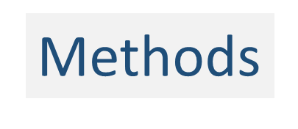
Advance Directives Completion Rates and an Intervention to Address Health Literacy in a Clinic Population
Additionally, for the intervention group only, the RA reviews and ‘walks through’ the 9 page Advanced Directives brochure and answers any questions. This will take 3-5 additional minutes.
The control patients will merely be handed the Advanced Directives manual with brief encouragement to complete and return it.

Slide 17
Advance Directives Completion Rates and an
Intervention to Address Health Literacy in a Clinic Population
Intervention Control
Adequate health literacy, receive intervention on advance directives | Adequate health literacy control group
Limited health literacy, receives intervention on advance directives | Limited health literacy control group
Adequate Literacy
Limited Literacy

Slide 18
Advance Directives Completion Rates and an Intervention to Address Health Literacy in a Clinic Population
Results?

Slide 19
Health Literacy at
Robert R Leverence MD FACP
Vice Chair Clinical Affairs Dept of Medicine
January 20,2017

